Slide 1
Civil society Voluntary Work and Community work
Friday 11.9.2015

Slide 2
Civil society Program of the day
9.00 – 9.15 Good morning, practical information and questions
9.15 – 9.45 Presentation: Voluntary Work in Denmark
Cooperation with government institutions
9.45 – 12.00 Voluntary Work in Kyrgyzstan? Group Work
Working in groups to produce material you can use as trainers
(Break 10.15 – 10.30)
12.00 – 13.30 Lunch break
13.30 – 14.00 Presentation: Examples of voluntary work in Denmark
14.00 – 16.00 How is it possible for you to strengthen the voluntary work in Kyrgyzstan?
(Break 15.30 – 15.45)
16.00 – 16.30 Presentation: Community work and participation
16.30 – 17.00 Evaluation of the day – Learning styles? (5 – 10 – 15 min.)
Notes:
Do you know that way of working?

Slide 3
Civil Society
A well-functioning welfare state requires not only a strong private and public sector, but also a strong and committed voluntary sector. Volunteering creates strong communities across generations and social backgrounds.
Notes:
The Government appreciates the tremendous effort many people make in voluntary work and recognize the necessity of the volunteer involvement and participation in the social field. A well-functioning welfare state requires not only a strong private and public sector, but also a strong and committed voluntary sector. Volunteering creates strong communities across generations and social backgrounds.
It is the public sector, which has the primary responsibility for marginalized children, youth and adults. The voluntary sector is an important addition, because it can create a different kind of trust and contact with other people.
Charter for the cooperation between the voluntary sector and the public sector The Charter for cooperation between the voluntary sector and the public sector describes the fundamental values and frameworks for interaction. It is prepared by representatives of the two sectors together back in 2001. Now it is about to be renewed and kept up-to-date.
More than 10 years have passed since the Charter was originally formulated. And both the voluntary sector, the public sector and the welfare state has changed significantly since then. The revitalized charter was published in summer 2013.

Slide 4
Voluntary Work in Denmark

Slide 5
Benefits of Voluntary Work in Denmark
Civic society and voluntarism constitute an alternative arena in which marginalised groups, as well as the unemployed workforce in general, can maintain and develop skills and establish and enhance access to social network .
In this domain it is possible to acquire or to re-acquire skills you may have lost.
Given the right organisational and political support, voluntarism is an open space for marginalised groups for a new chance to be included in social communities and society in general.

Slide 6
Facts on Voluntary Work in Denmark
Over 40% of the population are volunteers in one form or another
Around 2 million volunteers in total
Sports, nature, environment, elderly care, social care and healthcare tasks
1/3 of volunteers are active in social care and health care

Slide 7
What do we mean by volunteer?
People do it voluntarily
It is not paid
People do it for people outside their family
For the benefit of others than yourself and/or your family
Of a formal nature (unlike ordinary helpfulness and kindness)

Slide 8
Characteristics of Voluntary Social Work in Denmark
Many voluntary organizations organise activities for children, adults and the elderly throughout the country, entirely separate from the public professional sector
In Denmark volunteers are working more and more with the public professional sector around social interventions
There are currently a lot of focus on improving cooperation between the government and civil society
The aim of this cooperation is generally to improve inclusion of disadvantaged groups in regular communities

Slide 9
Voluntary cooperation in Denmark is going through a transformation
Traditionally, cooperation between private voluntary organizations and public efforts focus on:
New cooperation between the State and Civil Society - Voluntary Cooperation under transformation
Respect for uniqueness
Complementary to public welfare
Special financial support
Outsourcing and contract cooperation
Partnership
Co-creation
Coproduction = Cogeneration

Slide 10
Partnership
Structured, accountability, mutual benefit and dialogue based cooperation between different sectors
Demanding - requires time and resource to establish

Slide 11
Co-creation
Citizens are invited as partners = active and equal business partners for professional public authorities
Dialogue across differences
Creates greater insight, understanding and learning
Good dialogue between partners facilitates and creates equal working environments
Co-commission: common priorities and problem statements
Co-design: involvement of audience/target group as experts
Co-deliver: cooperation to develop solutions
Co-asses: Co-monitoring and co-evaluation
Notes:
Co-creation = samskabelse

Slide 12
Co-production
Background for co-production:
Increasingly complex problems cannot be solved by governance alone
It requires different resources, knowledge and forms of cooperation
More participation
More innovation
More local responsibility
Notes:
Co-production = Samproduktion

Slide 13
Volunteers in Kyrgyzstan? Group Work

Slide 14
Working in groups to produce material you can use as trainers
How is it here in Kyrgyzstan – does the poor, sick and vulnerable have good contact to other local residents and local community in general?
Is it natural that strong residents help the vulnerable people in local communities?
Which civil society organizations are there in Kyrgyzstan, and which targetgroups are they working with?
Draw a map of how civil society organisations are linked to the public sector.
Notes:
Tegn eksempel et kort over hvordan frivillige organisation relaterer til den offentlige sektor
på 9.45 – 10.15 Voluntary Work in Kyrgystan?
10.15 – 10.30 Break
10.30 – 12.00 Voluntary Work in Kyrgystan?
12.00 – 14.30 Lunch break

Slide 15
Civil society and Voluntary Work
Examples from Denmark

Slide 16
Volunteer Centres in municipalities Purpose
The overall objective of volunteer centres is to mobilize, publicize, support and develop the local volunteer work. They work to support the volunteerism that already exist, and provide specific assistance through the development of new initiatives and strengthening relations and networks between civic organisations and between civic organisations and the municipality or other stakeholders.
Notes:
In my presentation I will use the theory of change model which yo were working with some days ago
Purpose – target group, effekts and activities.

Slide 17
Volunteer Centres in municipalities Target population
Organisations or new initiatives that want to start a project or an association
Citizens who wish to volunteer or are seeking help and support from an organisation or another social stakeholder
Municipality or municipal institutions and other stakeholders that can help to promote social initiatives such as private companies or educational institutions

Slide 18
Volunteer Centres in municipalities Effect expected from the intervention
Increased quality of local voluntary social work through supporting, highlighting and inspiring existing voluntary work and helping new initiatives
Increased level of local voluntary work, making it easier to become a volunteer and find help and support for voluntary organisations
Increased social cohesion, through more holistic social initiatives by creating better networking and collaboration across the different organisations and between the organisations and the municipality or other relevant partners, so they can coordinate their work and share experiences

Slide 19
Volunteer Centres in municipalities Activities
Support and advice - for example advice and coaching on fundraising, recruitment and retention of volunteers
Helping new initiatives by offering new organisations office or work space and support with statutes, fundraising etc.
Volunteer Job Agency – acting as a point of connection between people wanting to volunteer and organisations or groups looking for volunteers
Providing facilities - meeting rooms and other facilities for organisations and projects

Slide 20
Volunteer Centres in municipalities Activities
Raise the profile of civic organisations - for example by publishing a list of local organisations or arrange different events to give visibility
Service support or practical help to copy, set up a folder, create a website, proofread a project fundraising application or contact to the municipality or other organisations
Courses, workshops and seminars for volunteers on topics that are relevant across organisations - for example, fundraising, recruitment or interview techniques
Coordination of local voluntary initiatives by forming and facilitating networking, cooperation and exchange of experience

Slide 21
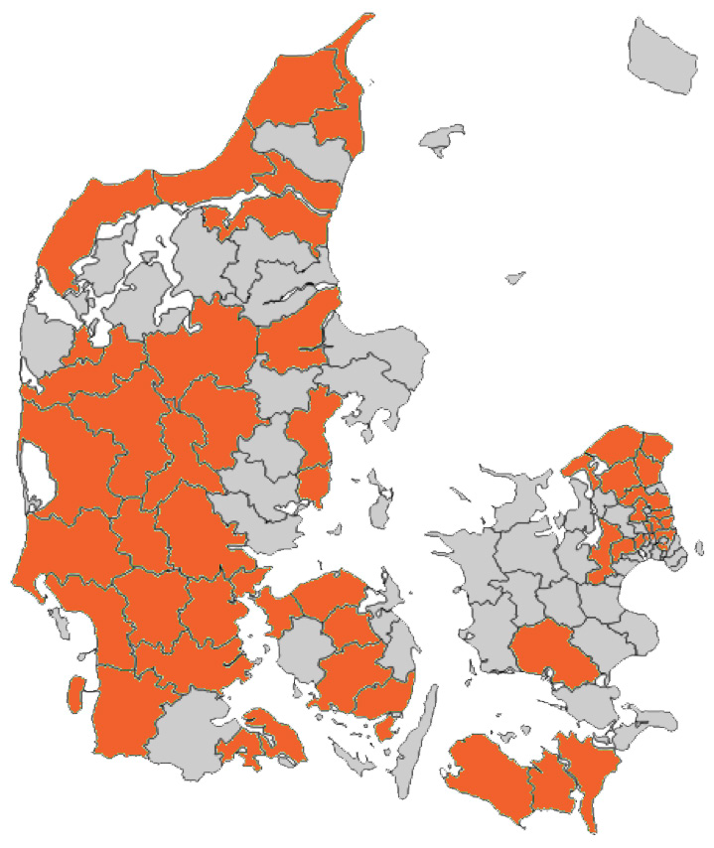
There are 58 volunteer centres in Denmark across 52 municipalities

Slide 22
Self-help groups Purpose
Participation in a self-help group allows people to share their stories and experiences in a group where all are equal.
How the groups works:
4-8 participants
Common topic - for example sadness, loneliness, illness or abuse
The group is initiated with a voluntary initiator / facilitator
The facilitator will leave the group when the group can function without the help
The group decide the meeting frequency and when the group is dissolved

Slide 23
Centre for Sexual Abuse Victims - a voluntary section.
A combination between professional therapeutic treatment and voluntary support in the form of counselling, social contact and human care
2 separate institutions with close cooperation
Easy access between the two institutions
Anonymity
Various routes of entry - as required

Slide 24
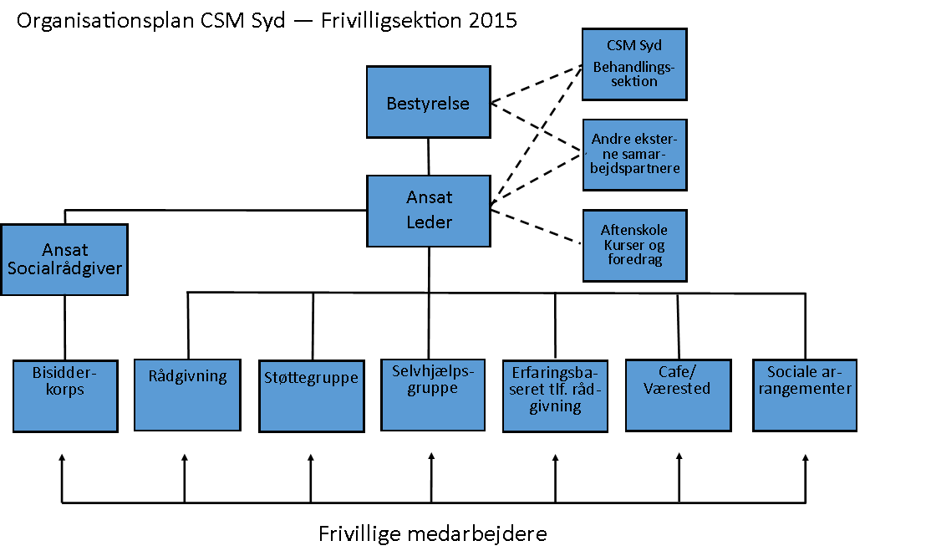
Centre for Sexual Abuse Victims – Example of cooperative structure
Volunteers

Slide 25
Centre for Sexual Abuse Victims – Recruitment of volunteers
CSM-South Volunteer Section is currently looking for voluntary counsellors and assistants.
Do you want to make a big difference for our many users, please let us know. You will of course be introduced carefully into the area.
All volunteers must work in confidentiality. Users can be anonymous if they wish and all voluntary workers must protect this confidentiality.
Some volunteers are previous victims. Others have a background that make them suitable to listen and help sexually abused people recover.
The volunteers attend a course at the centre, which further prepares the them for the counsellor function.

Slide 26
Centre for Sexual Abuse Victims – Phone counsellors
Phone counsellors are both women and men. They all have personal experience with incest and/or sexual assault. The counsellors have been helped to move forward and have gained valuable experience to help the callers. Phone counsellors are ready by the phone to be there for you:
To be "a listening ear," you can tell your feelings and thoughts
To give you a sense of not being alone with the problem
To listen without bias
To give a sense of familiarity by contributing their own experiences
To give hope for the future
If you need advice of a more formal nature, the experience-based voluntary phone counsellor can refer you to a contact centre during opening hours.

Slide 27
Strengthening Voluntary Work in Kyrgyzstan? Group Work

Slide 28
How is it possible for you to strength the voluntary work in Kyrgyzstan?
Make a project design for a social intervention in local area where you work with NGOs and volunteers.
Use the theory of change model
Use what you know about organising project work
Notes:
Inddrager = withdraw
14.30 – 15.30 Presentation: Concrete examples of voluntary work in Denmark
How is it possible for you to strength the voluntary work in Kyrgyzstan?

Slide 29
Community Work

Slide 30
Community Work
Active Citizenship in Kyrgyzstan
https://www.danchurchaid.org/where-we-work/central-asia/kyrgyzstan
Notes:
You alredy work with Community Work here in Kyrgyzsatan.

Slide 31
Community Work
Community Work is work that takes place in a local area with local citizens and groups and with local welfare organizations.
The purpose is:
To improve the interaction between local groups and increase the opportunity and ability of local citizens to propose and participate in solutions to local problems
The first and key task is to gain more knowledge and understanding about the local area you have to work in. There is a need for in-depth knowledge about both resources and problems

Slide 32
Community Work Research
Research in local communities takes time and requires trust - tread carefully and listen closely and deeply
Include as wide a range of sources of information as possible bringing in the voices of:
local people of all ages
public, private and voluntary sector representatives
minority and special interest groups
people from a spectrum of political and religious affiliations
And when you have completed your research
create a ”Theory of Change” with all the stakeholders
visualise your ”Theory of Change”
make all the decision about your project organisation

Slide 33
Community Work Key things to remember
In Community Work the local people are working together to change their local community for the better
The purpose is to empower people to use social innovation as a tool for positive social change
You start by recruiting a local team, and some local outreach workers
Working together with experts on how to create innovative social change
The tools must be accessible to everyone
Notes:
Outreach workers – dette opsøgende element skal nok uddybes lidt – har vi nogle specifikke opsøgende metoder?
The tools – præsentation af konkret værktøjer?

